Slide 1

Ruby on Rails (RoR)

Slide 2
What is Ruby on Rails (RoR) ?
An open source web framework.
Written in Ruby by David Heinemeier Hansson (aka DHH) in 2004.
You could develop a web application at least ten times faster with Rails than you could with a typical Java framework.
An open source Ruby framework for developing database-backed web applications.
Configure your code with Database Schema.
No compilation phase required.

Slide 3
Includes everything needed to create a database-driven web application, using the Model-View-Controller pattern.
Being a full-stack framework means all the layers are built to work seamlessly together with less code.
Requires fewer lines of code than other frameworks.

Slide 4

Who uses Rails

Slide 5
Rails Philosophy
Convention over configuration (no XML)
Don’t Repeat Yourself (DRY)
Rails is opinionated

Slide 6
RAILS STRENGTHS:
Rails used metaprogramming technique.
Rails introduces the Active Record framework, which saves objects into the database. The Rails version of the Active Record discovers the columns in a database schema and automatically attaches them to your domain objects using metaprogramming.
Convention over Configuration: If you follow the suggested naming conventions, Rails doesn't need much configuration.
Scaffolding: Rails can automatically create temporary code in the early stages of development to help get an application up quickly and see how major components work together.
Built-in testing: Rails creates simple automated tests you can then extend.
Three environments: Rails gives you three default environments: development, testing, and production.

Slide 7
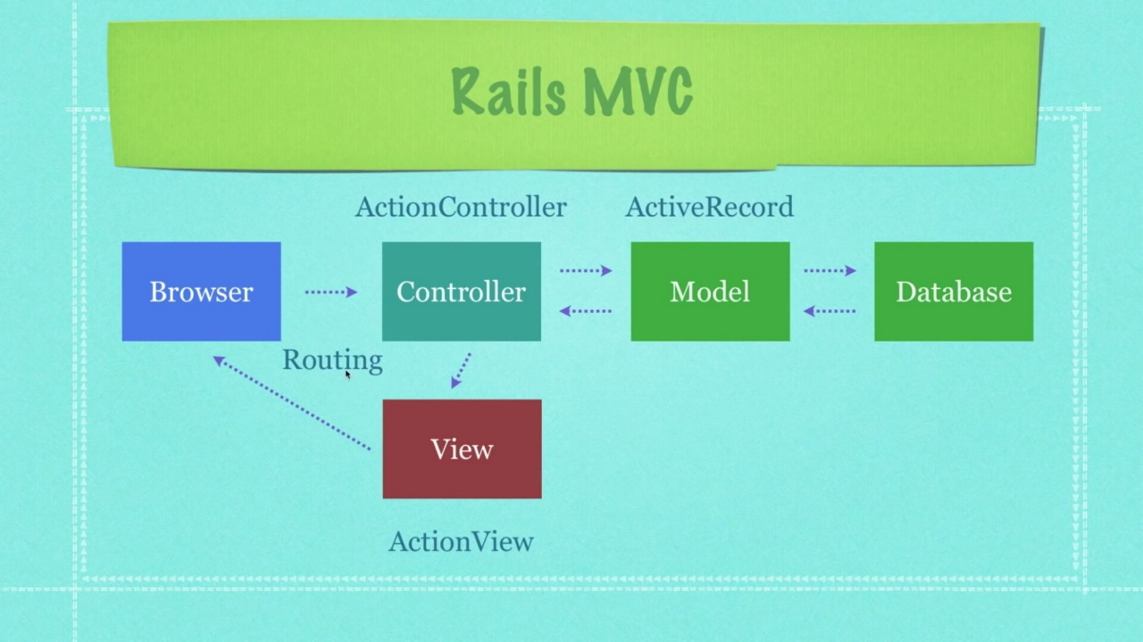

Slide 8
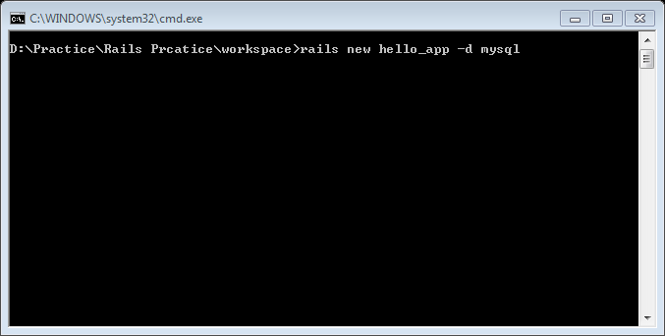
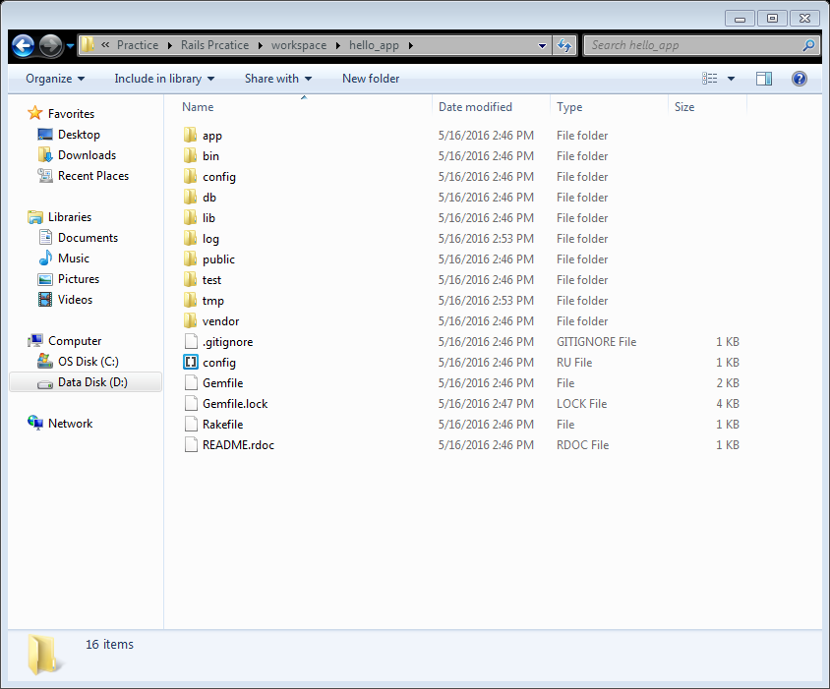
Create Your Rails Application:

Slide 9
app
app/controllers :Contains all the controller classes that handle a web request from the user.
app/helpers :Holds any helper classes used to assist the model, view, and controller classes.
app/models :Holds the classes that model and wrap the data stored in our application's database.
app/view − holds the display templates to fill in with data from our application, convert to HTML, and return to the user's browser.
app/view/layouts − Holds the template files for layouts to be used with views. Eg: header, footer
components − This directory holds components, tiny self-contained applications that bundle model, view, and controller.
config − This directory contains the small amount of configuration code that your application will need, db configurations, routes etc.
db − Usually, your Rails application will have model objects that access relational database tables.
doc − Ruby has a framework, called RubyDoc, that can automatically generate documentation for code you create.

Slide 10
lib − You'll put libraries here, unless they explicitly belong elsewhere (such as vendor libraries).
log − Error logs go here.
public − Like the public directory for a web server, this directory has web files that don't change, such as JavaScript files (public/javascripts), graphics (public/images), stylesheets (public/stylesheets), and HTML files (public).
script − This directory holds scripts to launch and manage the various tools that you'll use with Rails. .
test − The tests you write and those that Rails creates for you, all goes here.
tmp − Rails uses this directory to hold temporary files for intermediate processing.
vendor − Libraries provided by third-party vendors go here.
Apart from these directories, there will be two files available in demo directory.
README − This file contains a basic detail about Rail Application and description of the directory structure explained above.
Rakefile − This file is similar to Unix Makefile, which helps with building, packaging and testing the Rails code. This will be used by rake utility supplied along with the Ruby installation.

Slide 11
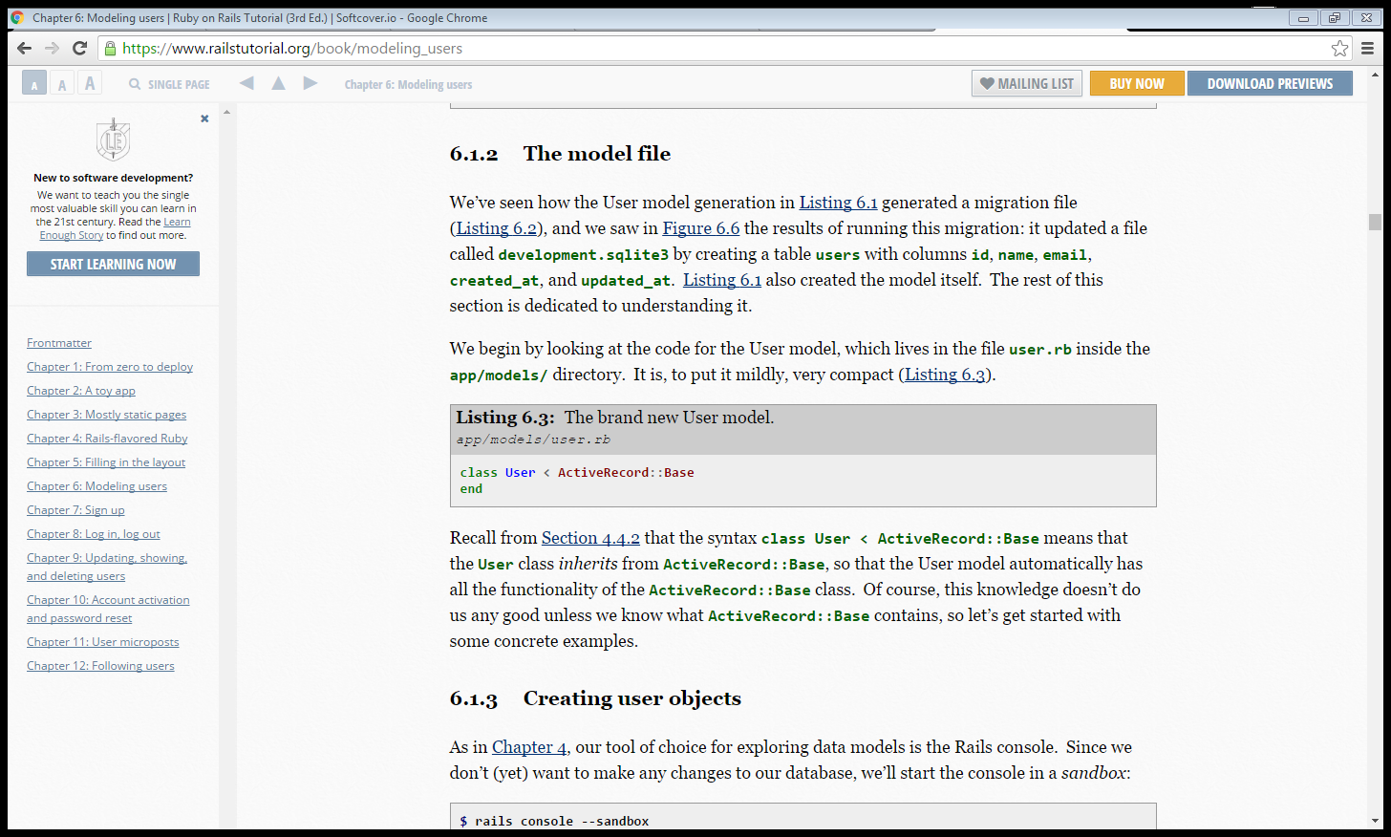
RAILS with MySQL
Step 1: Create a database with name projectName_development.
Step 2 : Update the library/config/database.yml file with your database’s username and password.
Create a Model.
Eg: $ rails generate model User name:string email:string.
This creates a Model “User” with attributes name and email.
$bundle exec rake db:migrate
This creates a table User with columns name and string in your database.

Slide 12
Models and Relationships:
class User < ActiveRecord::Base
has_many :tweets
end
class Tweet < ActiveRecord::Base
belongs_to :user
end

Slide 13
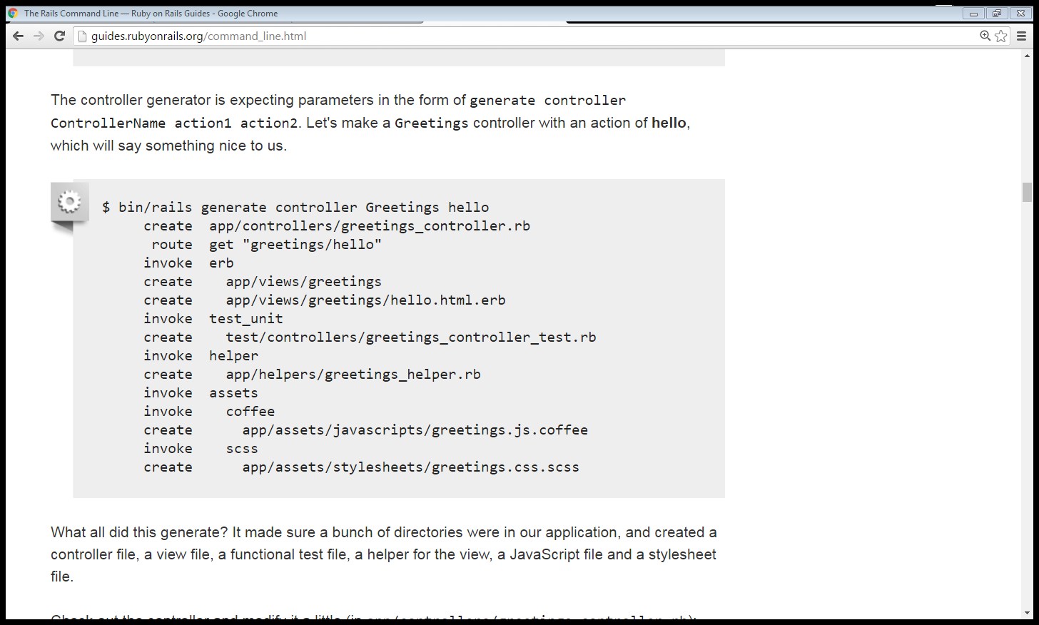
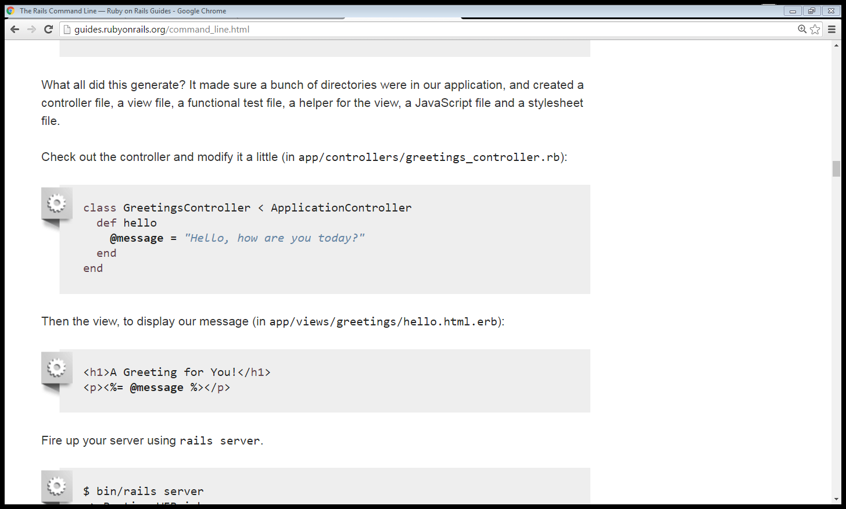
Controller:
The Rails controller is the logical center of your application. It coordinates the interaction between the user, the views, and the model.

Slide 14
CRUD Methods in your controller
Display List Of All Users
def index
@users = User.all
end
Show a User
def show
@user = User.find(params[:id])
end
The ‘new’ method
def new
@user = User.new
end

Slide 15
CRUD Methods in your controller(contd.)
The ‘create’ method
def create
@user = User.create(params.require(:user).permit([:name, :location])
end
User’s parameters will be received in this format
{:name => “User’sName”, :location => “User Location”}
The ‘update’ method
def update
@user = User.find(params[:id])
@user = User.update(params.require(:user).permit([:name, :location])
end
The ‘delete’ method
def delete
User.find(params[:id]).destroy
redirect_to :action => 'list'
end

Slide 16
Views:
Views for your project will be saved in the following location
--app/views/controller_name/action_name.html.erb
.ERB- is the extension indicating that your html file has embedded ruby code in it.
This code is enclosed in either <%..%> or <%=.. %>.
<%..%> is used to have methods etc . And nothing gets printed on your html page.
If you wish to display something like the output of the method on a html page use <%=.. %>.

Slide 17
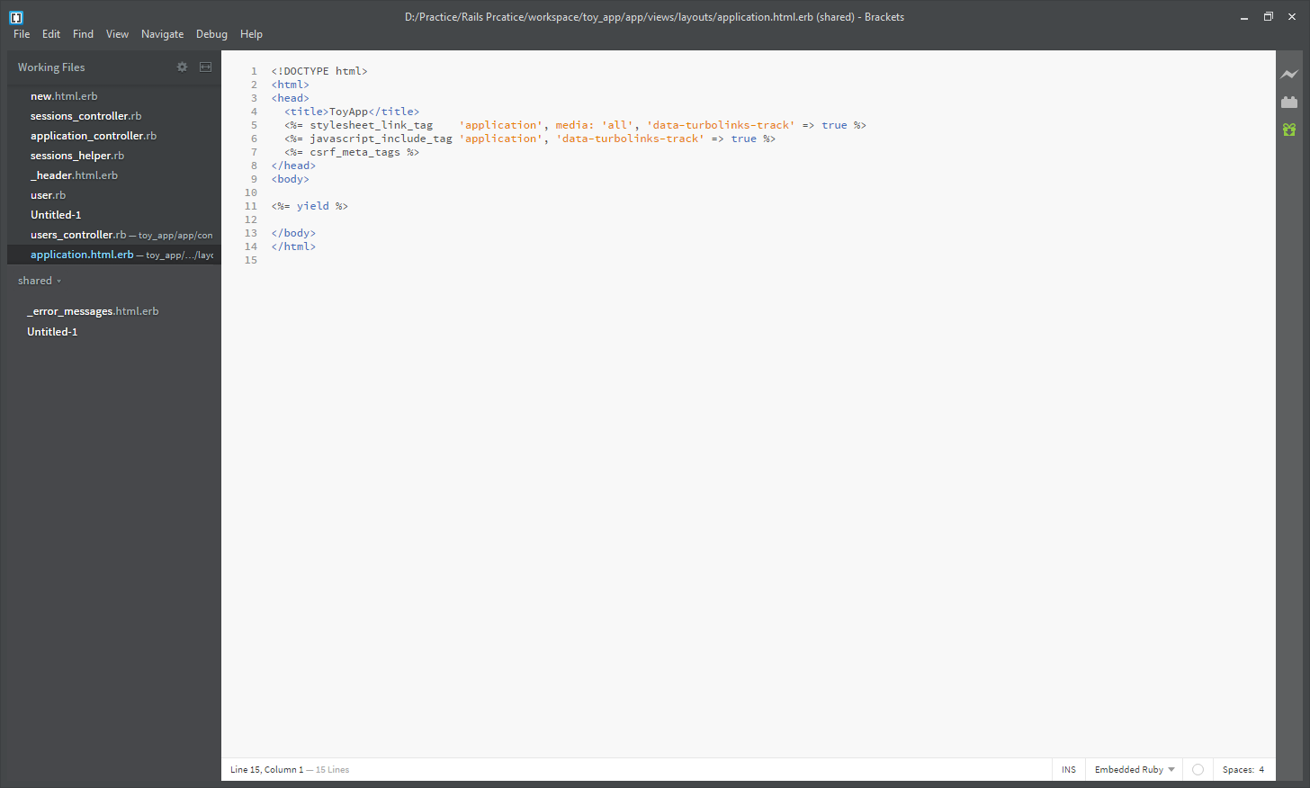
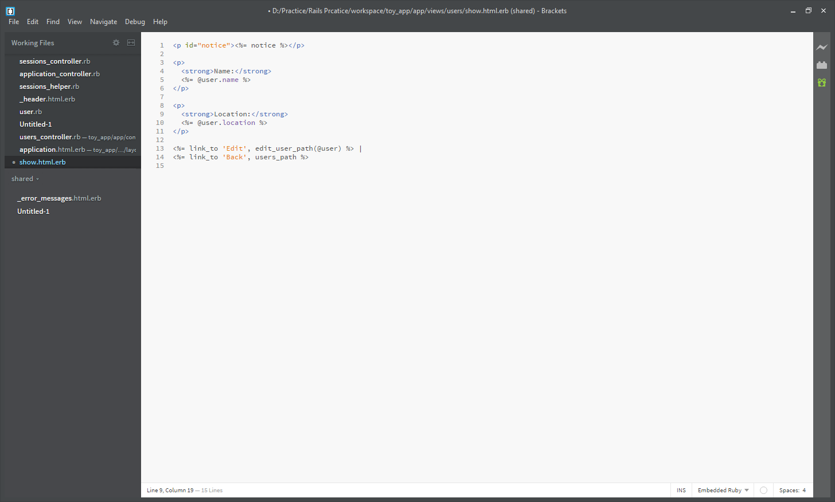
This file contains code that is common to all your views. The <%= yield %> displays all your view for each individual page.
This is the html page to show a user. This when placed in yield gives us our final html page view on our browser.

Slide 18
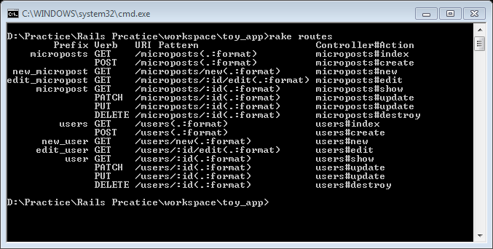
Routes:
Include the line : resources :users in your config/routes.rb file.

Slide 19
In order to get all users, the Route used is
get ‘/users’ => “users#index”
method
http verb
controller
path
You can customize the path by including this line in your routes.rb file
get ‘/all’ => “users#index”

Slide 20
THANK YOU

